Slide 1




Notes:
Isaac
Salesman pitch.
Fresh coffee brewing right before you wake up, doggy doors that open automatically when the dog comes near, and space shuttle launches at the push of a button.
Does this interest you? Well, this IZ the home automation kit for you!

Slide 2

IZ-Kit
Ezekiel Enns and Isaac Wittmeier
Notes:
Hello, I’m Isaac Wittmeier and I’m here with Ezekiel Enns to
Introduce to you the Izzy-Kit, also pronounced as an is-Kit.

Slide 3

Contents:
What is an IZ-Kit
Client Modules
Website
Backend server
Notes:
We will begin with an overall explanation of what the project is.
And then discuss the three main components that work together to form the IZ-Kit,
the IZ-Kit client modules,
The IZ-Kit website, and finally the IZ-Kit backend server

Slide 4

What is an IZ-Kit?
Notes:
- it iz this kit,
- home automation systm
- using single funcation modules
- focus on user defined systems
[to break down how it works ]

Slide 5

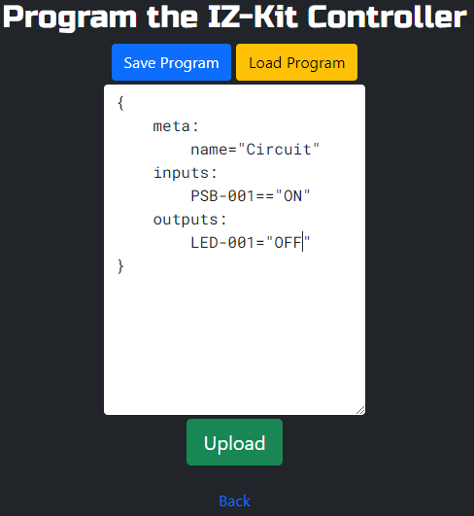
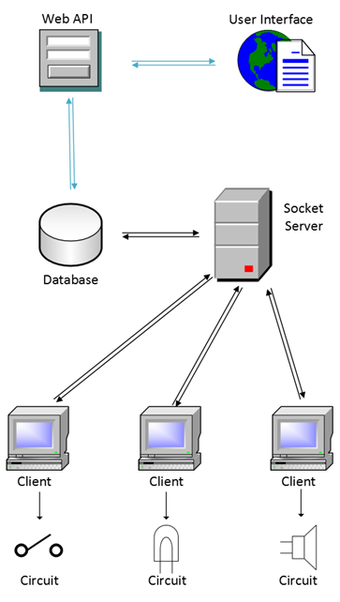
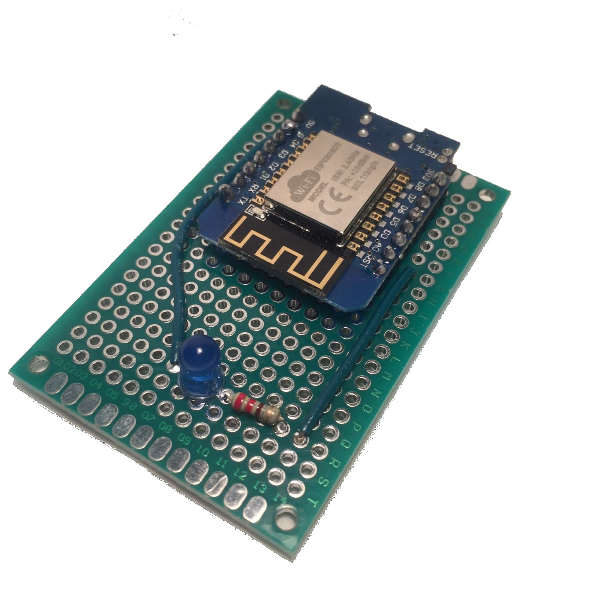
Notes:
- there are several single purpose Input and output modules
- connect to a server
- users then define how modules will interact on the server
- by creating conigis using web interface
[let see this in action]

Slide 6
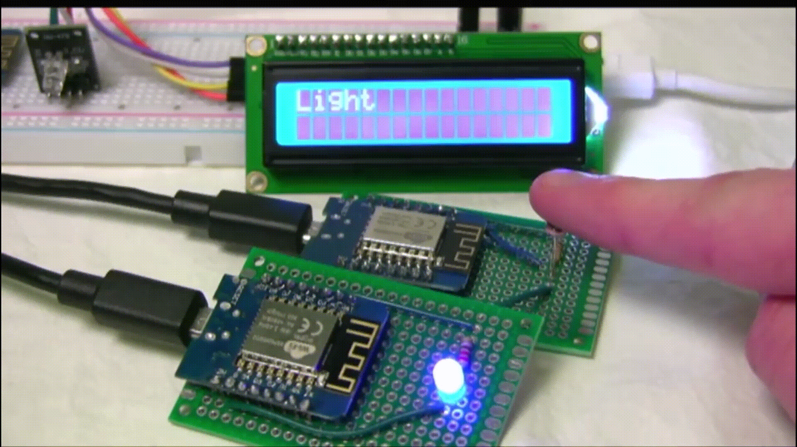
Notes:
- 3 single purpose modules
- configed to...
- to read relative brightness
- display dark when dark
- display light when light
- turn on a LED when light and off when dark
[now lets talk more about these modules]

Slide 7
Client Modules
Notes:
- The client modules are the inputs and outputs of the system
- They are designed to modular allowing a user to add any input or output to the
System that they desire
- They come in both hardware and software forms

Slide 8
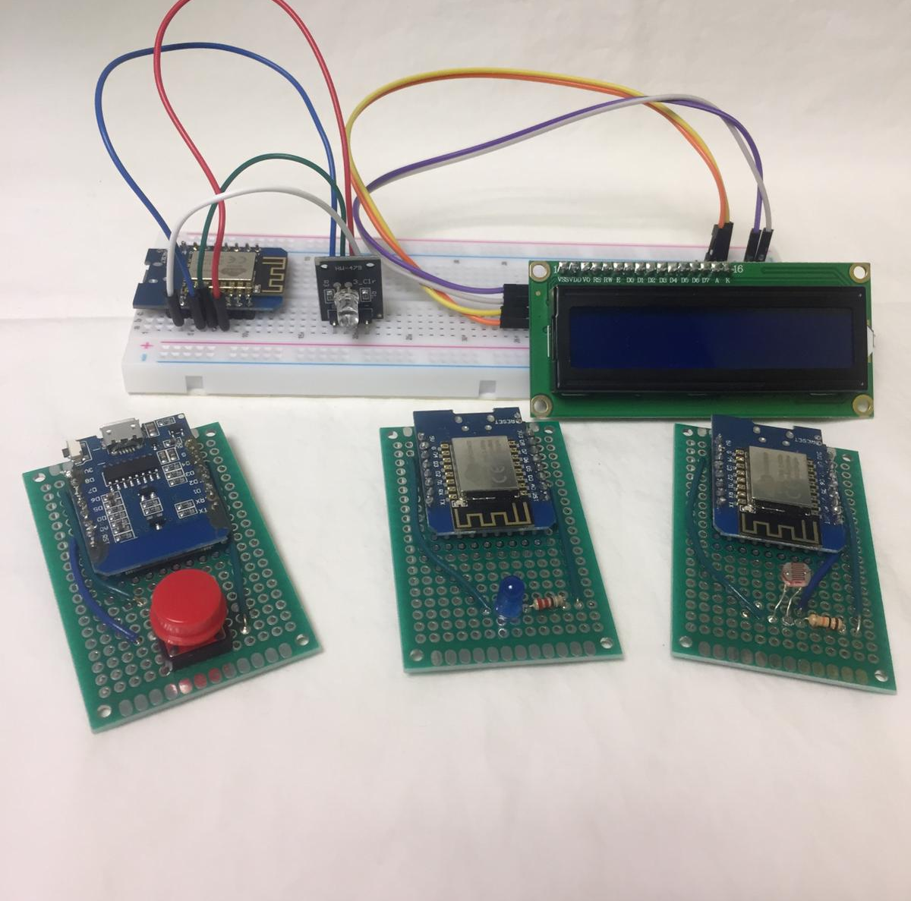

Hardware Modules:
Pushbutton, RGB LED, LED, I2C LCD, light sensor
C++ software
Notes:
Isaac
Types of modules in prototype kit: Pushbutton, RGB LED LED, i2c LCD, Light sensor
Utilize a wemos d1 mini clone, a wireless microcontroller based on ESP8266 chip
operating on USB power
No batteries due to scope and time constraints
Using the base code written in C++, it’s quite easy to make any input
or output imaginable

Slide 9
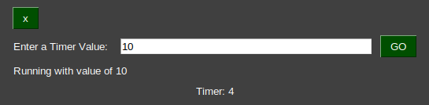
Software Modules
Same connection structure
Unlimited types
Discord Bots, email notifiers, timers, and more
Notes:
- we also created software modules
- these are designed to be run by the user on any machine
- we only created one but many more could be created
- this is a 1 second retaping timer
- we designed our development in such a way
- easy to port over to other api's
- for example discord
[and how is this all possible...]

Slide 10
Connection Class
Modular development
Easy port to other languages
Virtual Modules
Notes:
- we had module development in mind
- we made a general purpose connection class
- fist c++ for ardunio
- ported to python
- Ardino
- A community is for hobbyists
- documentation is extremely vague
- had to go into the library code
- reverse engineer the functions
[and that’s how we got it to work]

Slide 11
Web Application
Notes:
The web application has been created with an HTML/CSS/Javascript/Bootstrap interface. It uses a PHP backend
It also includes a REST API that allows the pages to send Ajax requests to the server to get updated device
Information and upload and delete programs.
There are three major parts to the web interface that controls the devices
1. User accounts
2. Admin panel
3. Programming page

Slide 12
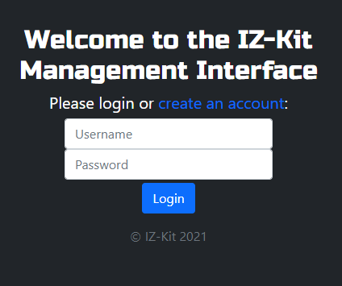
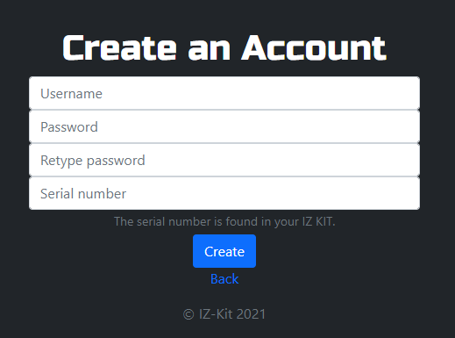
User Accounts
Security
Different programs per user
Notes:
Website features user accounts mainly for security purposes
If a user chooses to port-forward an instance of the server, it will provide a layer of security
When creating an account, a serial number is required
Physical key that comes with the kit
Prevents those who don’t have physical account from gaining access and wreaking havoc on the system

Slide 13
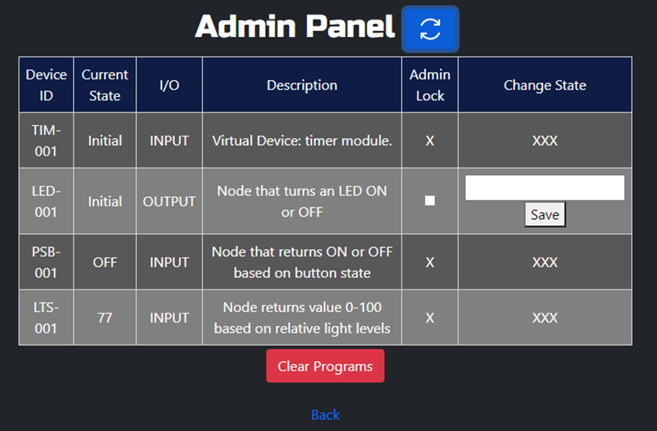
Admin Panel
View current states
Change output states
Clear programs
Notes:
Allows manual control over the devices
Allows users to view the current states of both input and output modules
Allows users to change states of output modules
Another feature on the admin panel is the ability to clear all the currently programmed circuits
Which we’ll get to in the next slide

Slide 14
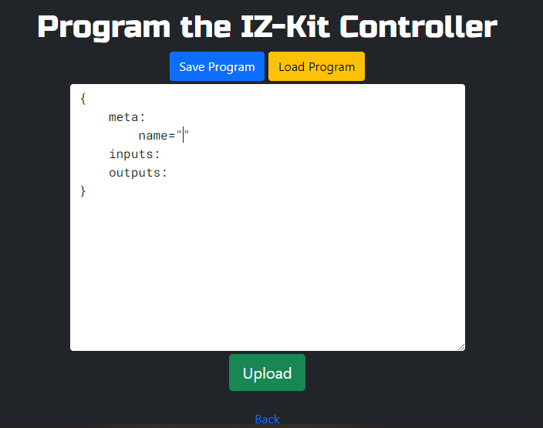
Programming Page
Save/Load/Upload programs
Features IDE shortcuts
Notes:
Main part of the website
Allows for the actual programming of the IZ-Kit modules through the creation of virtual circuits
Packages the text up as JSON and fires it to a PHP REST client to be inputted into the database
Includes saving and loading of one file per user
Includes a few IDE style shortcuts such as ## [Enter] creates a
template as seen in the picture on this slide
Also creates closing quotes for you when you type an opening quote
and it includes some spacing and tabbing assistance
- You will be able to see some of these helpful features in the sample program on the next slide

Slide 15
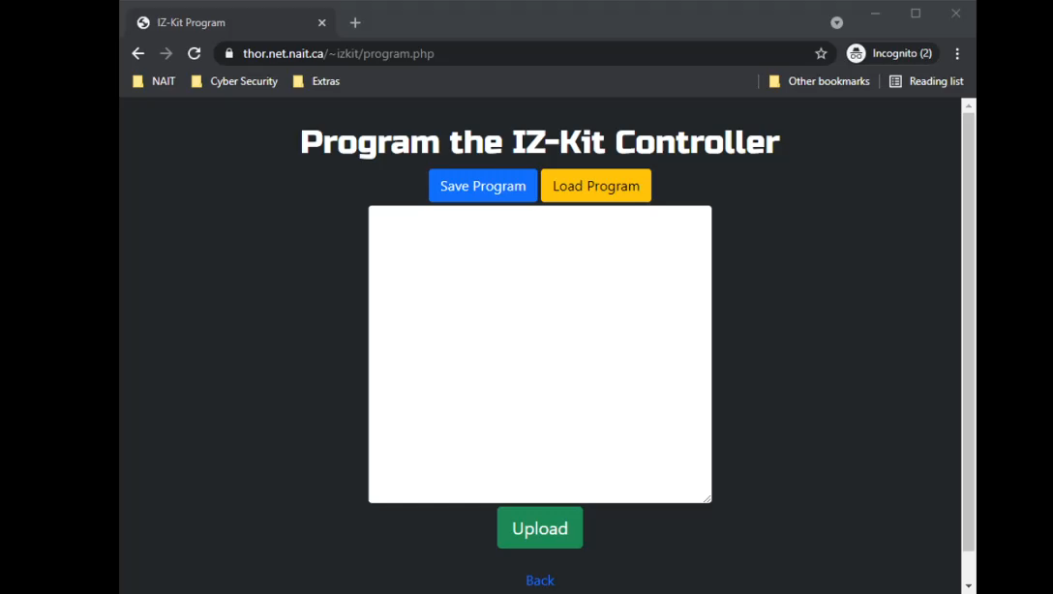
Sample Program
Meta information
Inputs
Output
Notes:
Here is a sample of IZ-Language: V1.
First: meta information at the top,
Unlimited fields allowed, only the name field is stored in the database, the rest is just for humans, such as description here
Second: one or more inputs conditions that all have to be true to fire all the outputs below
There is an ID of which its value is compared to the value in quotes
Third: list of outputs which change their state to value in quotes when event is true
States don’t reset when an event deactivates. This allows for added flexibility in programming as you can
Program what resets the state or if it even resets at all
In V1 of the language, spaces and a few other symbols don’t work inside the quotes due to the way the Regex parsing was designed.
If a V2 of the Language was made, this would be fixed

Slide 16
Backend Server
Notes:
- moving parts
- time to conceptualize
- self hosting was not implemented
- but kept in mind
[so lets talk about its development]

Slide 17
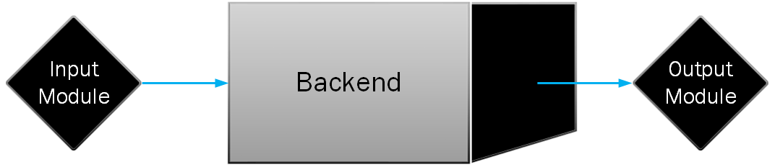
Notes:
- black box
- input state in
- output states out
[now lets peel back what's making this work]

Slide 18
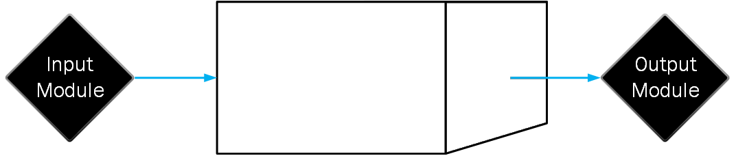



Notes:
- made up of three parts
- Rest API ->
- config module relationships
- stored in the database
- socket server ->
- conn mod to database
- enacts behaviors defined in the database
- database
- stores all module states
- and relationships between mods
- may ask
- reuse http requests for mod comm
- we found this caused to much latency and sockets fixed this
- meet us after words to talk
- database makes this complex system run
[ and heres how it works ]

Slide 19
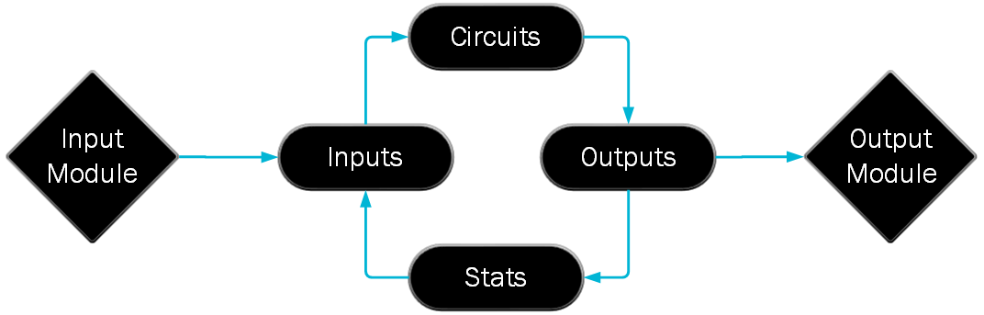
Notes:
- there are 4 main parts to the db
- first stats table
- stores all module states
- both in and out
- inputs table
- checks the state of a mod
- on desired state
- identifies itself as triggered
- circuits table
- conn to several inputs
- once all conn are triggered
- it also identifies itself as triggered
- outputs table
- like the inputs table
- conn to mod
- circuit
- on circuit trigg
- sets conn mod to a defined state
- round circle
- optimizations
- behavior is in socket server
- achvied by sql triggers and procedures
- result in potential speed
- renforces Single-responsibility principle
[that concludes the back end]

Slide 20
Notes:
Isaac
With this amazing kit, you can now have all those comforts I mentioned,
All at the press of an IZ-Kit button! Now go launch some space shuttles!

Slide 21
Thank you!
Special thanks:
Herb Vanselow
Steven Dytiuk
All CNT instructors
You for watching
Notes:
Special thanks to Herb Vanselow for his insight into sockets and technology support
Special thanks to Steven Dytiuk for always being there for us his constant support and inspiration
-> he gave us inspiration on calling it IZ-Kit
-> let’s not get into almost calling it a Kaboodle and Kadooble kit…
Thank you to all the CNT instructors -> helped us through college
Also like to give a special thanks you to for watching!

Slide 22
Questions?

Slide 23
Questions?

